Slide 1

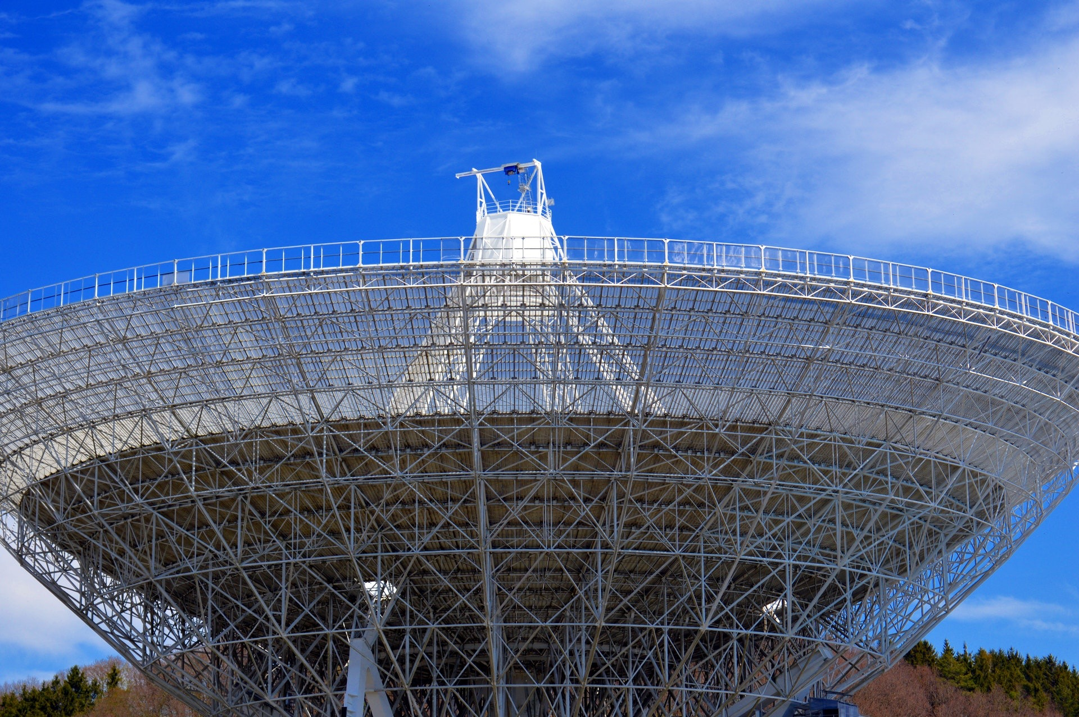

Introduction to communication system communication system analysis Group-28
Assigned by
Prof. Yash Vasavada

Slide 2

201801436 : VISHAL PATEL
201801437 : RAJ BHAVSAR
201801438 : HIREN CHAUDHARY
201801439 : NAMAN DAVE
201801440 : TUSHAR PATIL
201801441 : MEET BHALODI
201801442 : DISHITA THAKER
201801443 : DEEP PATEL
201801444 : BHAVYA GANATRA
201801445 : ISHWA BHATT
201801446 : RAJVIBA GOHIL
201801447 : ADHISH BORAD
CONTRIBUTORS

Slide 3


Honor code
We declare that
→ The work that we are presenting is our own work.
→ We have not copied the work (the code, the results, etc.) that someone else has done.
→ Concepts, understanding and insights we will be describing are our own.
→ We make this pledge truthfully. We know that violation of this solemn pledge can carry grave consequences.

Slide 4
Project flow
Introduction
Logic for the codes
Analysis
Conclusion

Slide 5

PROBLEM STATEMENT
The aim is to create an efficient message passing channel encoder and decoder for product and ldpc codes.

Slide 6
BLOCK DIAGRAM
ENCODER
CHANNEL
DECODER

Slide 7
LOGIC FOR ENCODER (PRODUCT CODE)
FOR ANY K BIT LONG INFORMATION SEQUENCE, THE ENCODED MESSAGE BECOMES N BIT LONG WHERE
N = (√K+1)²
FOR ENCODING A K BIT MESSAGE WE CREATE A GENERATOR MATRIX OF DIMENSIONS ‘N × K’ WHICH IS THEN MULTIPLIED TO A MESSAGE MATRIX OF DIMENSIONS ‘K × 1’. HENCE THE ENCODED MESSAGE IS A MATRIX OF DIMENSIONS ‘N × 1’.
THE ENCODED MESSAGE ACTS AS AN INPUT FOR THE CHANNELS.

Slide 8
Generator matrix
1 | 0 | 0 | 0
0 | 1 | 0 | 0
0 | 0 | 1 | 0
0 | 0 | 0 | 1
1 | 1 | 0 | 0
0 | 0 | 1 | 1
1 | 0 | 1 | 0
0 | 1 | 0 | 1
1 | 1 | 1 | 1
G =

Slide 9
Parity check matrix
Advanced H matrix
[ 1, 1, 0, 0, 1, 0, 0, 0, 0 ]
[ 0, 0, 1, 1, 0, 1, 0, 0, 0 ]
[ 1, 0, 1, 0, 0, 0, 1, 0, 0 ]
[ 0, 1, 0, 1, 0, 0, 0, 1, 0 ]
[ 1, 1, 1, 1, 0, 0, 0, 0, 1 ]
[ 0, 0, 0, 0, 1, 1, 0, 0, 1 ]
[ 0, 0, 0, 0, 0, 0, 1, 1, 1 ]
1 | 1 | 0 | 0 | 1 | 0 | 0 | 0 | 0
0 | 0 | 1 | 1 | 0 | 1 | 0 | 0 | 0
1 | 0 | 1 | 0 | 0 | 0 | 1 | 0 | 0
0 | 1 | 0 | 1 | 0 | 0 | 0 | 1 | 0
1 | 1 | 1 | 1 | 0 | 0 | 0 | 0 | 1
H =

Slide 10
CHANNELS
USING THE ‘RANDINT’ FUNCTION IN PYTHON WE GENERATE A RANDOM NUMBER BETWEEN 0 & 99 (including both). IF THAT TURNS OUT TO BE LESS THAN P×100 ( P = ERROR INTRODUCING PROBABILITY OF THE CHANNELS )
IN BEC : THE BIT IS ERASED ( UPDATED TO -1 IN THE CODE ).
IN BSC : THE BIT IS UPDATED TO THE XOR OF THE ORIGINAL BIT WITH 1. HENCE FLIPPING THE BIT.

Slide 11
LOGIC FOR DECODER
FOR BEC
PARITY CHECK MATRIX OF DIMENSION ‘((N-K) × N)’ IS MADE AND AN ITERATIVE ALGORITHM IS CALLED.
THE ALGORITHM CAN BE EXPLAINED AS FOLLOWS

Slide 12
REPRESENTATION OF TANNER GRAPH
S1
S2
S3
S4
S5
S6
S7
m1
m2
m3
m4
m5
m6
m7
m8
m9

Slide 13
For BEC
E | E | 1
0 | 0 | 0
0 | 1 | 1
ORIGINAL MESSAGE
M= [ 0, 1, 0, 0 ]
ENCODED MESSAGE
M=[ 0, 1, 0, 0, 1, 0, 0, 1, 1 ]
RECEIVED MESSAGE
M= [ E, E, 0, 0, 1, 0, 0, 1, 1 ]
M =
E = ERASED BITS
1 | 1 | 0 | 0 | 1 | 0 | 0 | 0 | 0
0 | 0 | 1 | 1 | 0 | 1 | 0 | 0 | 0
1 | 0 | 1 | 0 | 0 | 0 | 1 | 0 | 0
0 | 1 | 0 | 1 | 0 | 0 | 0 | 1 | 0
1 | 1 | 1 | 1 | 0 | 0 | 0 | 0 | 1
H =

Slide 14
REPRESENTATION OF TANNER GRAPH
S1
S2
S3
S4
S5
S6
S7
E
E
0
0
1
0
0
1
1

Slide 15
STEP 1
S1
S2
S3
S4
S5
S6
S7
0
E
0
0
1
0
0
1
1

Slide 16
STEP 2
S1
S2
S3
S4
S5
S6
S7
0
1
0
0
1
0
0
1
1

Slide 17
IMPLEMENTATION OF TANNER GRAPH IN CODE
[ E E 0 0 1 0 0 1 1 ]
1 | 1 | 0 | 0 | 1 | 0 | 0 | 0 | 0
0 | 0 | 1 | 1 | 0 | 1 | 0 | 0 | 0
1 | 0 | 1 | 0 | 0 | 0 | 1 | 0 | 0
0 | 1 | 0 | 1 | 0 | 0 | 0 | 1 | 0
1 | 1 | 1 | 1 | 0 | 0 | 0 | 0 | 1
H =

Slide 18
Decoding Of C1 :
Iteration 1:
There is consideration of C1 bit in the first row(of H matrix), so we can find it’s value by taking it’s XOR. But the problem is, C2 bit is also erased. So C1 can’t be recovered from the first row.
C1 bit is not considered in second row, so it can’t be recovered.
Now, in third row there is C1 bit and also, there are no erasure bits. Hence, C1 can be recovered by taking XOR of the message bits corresponding to the indices where the value is 1. (Here, it is C3 and C7)
After finding C1, the loop will break. The message bit will then be updated.
The loop will terminate after the very first iteration.
Decoding of C2 also happens in this way.
Hence the original bits are DECODED.

Slide 19



FOR (9, 4) PRODUCT CODE
P(S) = P(S, E=0) + P(S, E=1) + P(S, E=2) + P(S, E=3) + … + P(S, E=9)
= P(S/E=0)×P(E=0) + P(S/E=1)×P(E=1) + P(S/E=2)×P(E=2) + … + P(S/E=9)×P(E=9)
= $\frac{POSSIBLE_CASES}{9C0}$ × ⁹C₀ × P⁰ × (1 – P)⁹ + … + $\frac{POSSIBLE_CASES}{9C9}$ × ⁹C₉ × P⁹ × (1 - P)⁰
[ p⁰(1-p)⁹ p¹(1-p)⁸ …. P⁹(1-p)⁰ ]
[ possible_cases (E = 0) ]
[ possible_cases (E = 1) ]
[ . ]
[ . ]
[ . ]
[ possible_cases (E = 9) ]
×
FOR FIXED PROBABILITY
E = ERROR
S = SUCCESS

Slide 20
FOR (N, K) PRODUCT CODE
P(S) = P(S, E=0) + P(S, E=1) + P(S, E=2) + P(S, E=3) + … + P(S, E=N)
[ p⁰(1-p)^{N} p¹(1-p)^{N-1} …. P^{N}(1-p)⁰ ]
×
[ possible_cases (E = 0) ]
[ possible_cases (E = 1) ]
[ . ]
[ . ]
[ . ]
[ possible_cases (E = N) ]

Slide 21
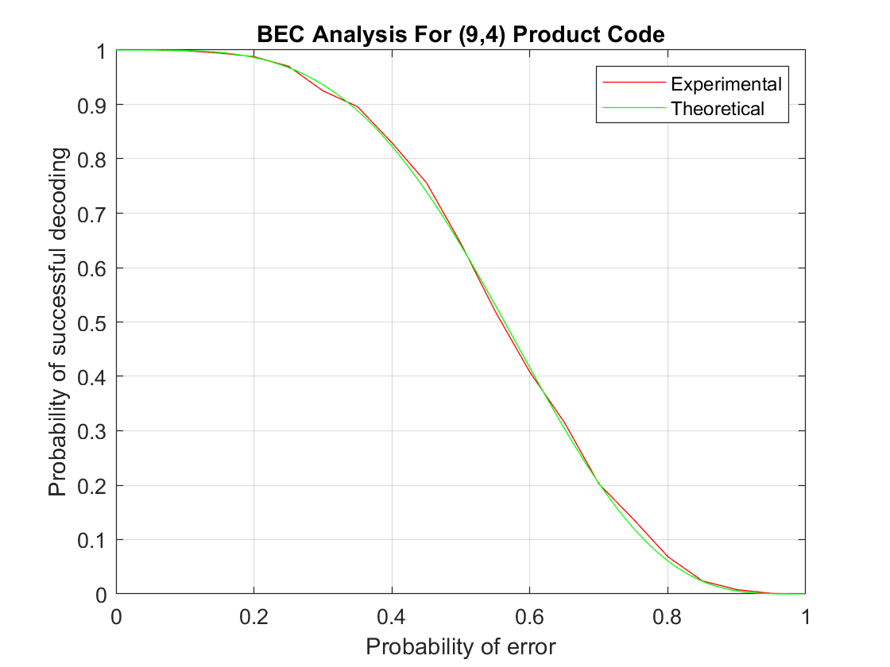
BEC ANALYSIS
THIS GRAPH COMPARES OUR EXPERIMENTAL VALUES WITH THE THEORETICAL VALUES CAME FROM THE EQUATION MADE FROM DIFFERENT VALUES OF PROBABILITY OF SUPPORT MATRIX.
BOTH THE GRAPHS ALMOST OVERLAPS WITH EACH OTHER WHICH SHOWS THAT OUR ESTIMATIONS OF THE NUMBER OF CASES IN WHICH THE RECEIVED MESSAGE SIGNAL IS CORRECTLY DECODED ARE CORRECT.
AS THE PROBABILITY OF ERROR INCREASES, THE PROBABILITY OF SUCCESS DECREASES.

Slide 22
EQUATION FOR BEC (9, 4)
P(S) = P⁰ (1-P)⁹ + 9 × P (1-P)⁸ + 36 × P² (1-P)⁷ + 84 × P³ (1-P)⁶
+ 117 × P⁴ (1-P)⁵ + 81 × P⁵ (1-P)⁴
S = PROBABILITY OF SUCCESS

Slide 23
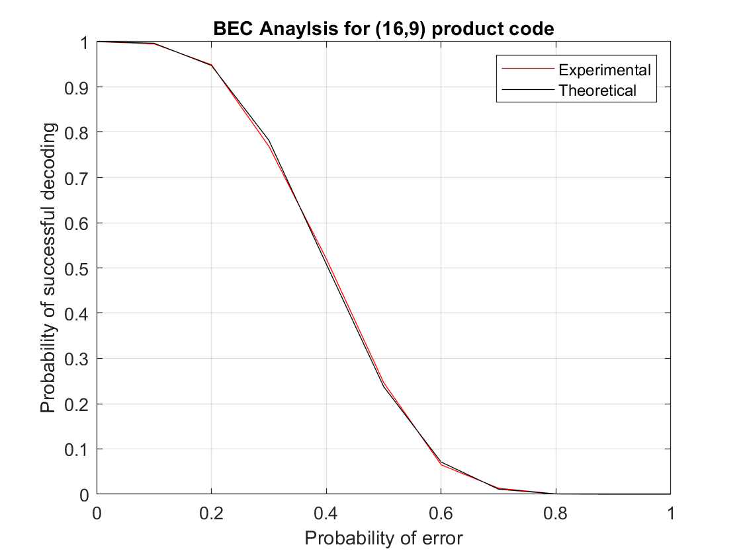
EQUATION FOR BEC (16, 9)
P(S) = P⁰ (1-P)¹⁶
+ 16 × P (1-P)¹⁵
+ 120 × P² (1-P)¹⁴
+ 560 × P³ (1-P)¹³
+ 1784 × P⁴ (1-P)¹² + 3936 × P⁵ (1-P)¹¹
+ 5632 × P⁶ (1-P)¹⁰
+ 3520 × P⁷ (1-P)⁹

Slide 24
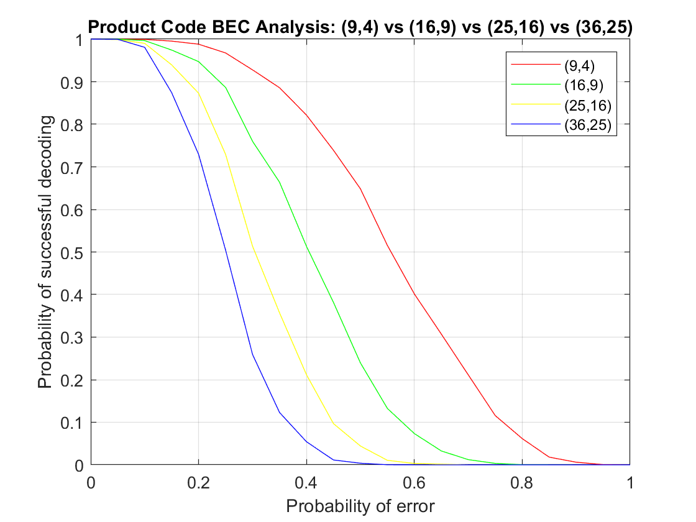
As the number of message bits increases, the probability of success decreases for the same probability of error.
It is because that the number of parity check bits does not increase to the extent in which the information bits increases.
Also, the number of unsuccessful decoding cases increases with increase in number of information bits for same probability of error.

Slide 25
ADVANCED H ANALYSIS FOR (9, 4) PRODUCT CODE ADVANCED H MATRICES
H1 matrix
[1, 1, 0, 0, 1, 0, 0, 0, 0]
[0, 0, 1, 1, 0, 1, 0, 0, 0]
[1, 0, 1, 0, 0, 0, 1, 0, 0]
[0, 1, 0, 1, 0, 0, 0, 1, 0]
[1, 1, 1, 1, 0, 0, 0, 0, 1]
H2 matrix
[1, 1, 0, 0, 1, 0, 0, 0, 0]
[0, 0, 1, 1, 0, 1, 0, 0, 0]
[1, 0, 1, 0, 0, 0, 1, 0, 0]
[0, 1, 0, 1, 0, 0, 0, 1, 0]
[0, 0, 0, 0, 1, 1, 0, 0, 1]
Advanced H matrix
[1, 1, 0, 0, 1, 0, 0, 0, 0]
[0, 0, 1, 1, 0, 1, 0, 0, 0]
[1, 0, 1, 0, 0, 0, 1, 0, 0]
[0, 1, 0, 1, 0, 0, 0, 1, 0]
[1, 1, 1, 1, 0, 0, 0, 0, 1]
[0, 0, 0, 0, 1, 1, 0, 0, 1]
[0, 0, 0, 0, 0, 0, 1, 1, 1]
H3 matrix
[1, 1, 0, 0, 1, 0, 0, 0, 0]
[0, 0, 1, 1, 0, 1, 0, 0, 0]
[1, 0, 1, 0, 0, 0, 1, 0, 0]
[0, 1, 0, 1, 0, 0, 0, 1, 0]
[0, 0, 0, 0, 0, 0, 1, 1, 1]

Slide 26
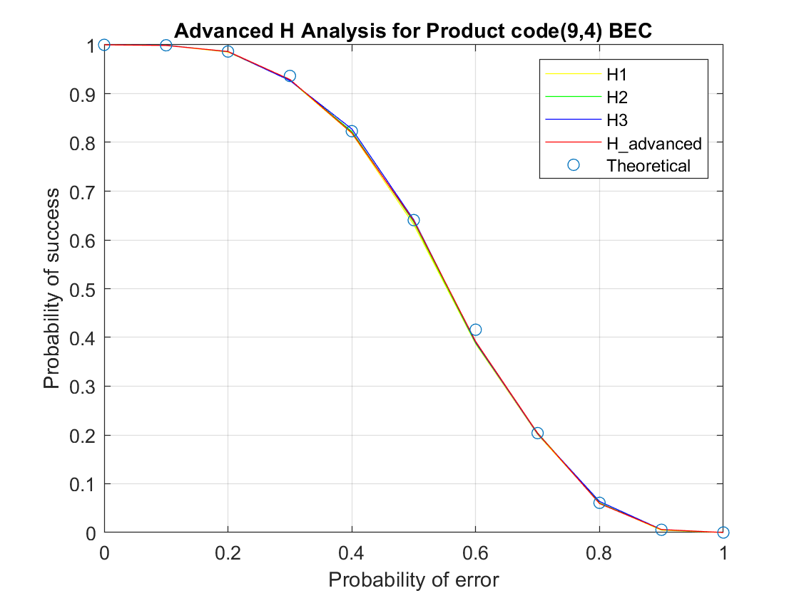
ADVANCED H ANALYSIS FOR (9, 4) PRODUCT CODE
Here H1 is the parity check matrix considering all the message bits.
H2 being the parity of the column and H3 the parity node for the rows.
H-Advanced is the one having ((N-K+2) × N ) dimensions.
The graphs almost match each other except for the fact that the H_Advanced gives a more accurate analysis when compared to the theoretical analysis.

Slide 27
WE CAN NOT SEE CLEAR DIFFERENCE BETWEEN THIS FOUR H MATRIX’S ANALYSIS
SO WE TOOK ABSOLUTE DIFFERENCE BETWEEN THEORETICAL ANSWER AND THESE FOUR MATRIX’S PRACTICAL VECTORS AND AFTER SUMMING UP THESE VECTOR ELEMENTS WE GOT:
DIFFERENCE SUM = SUM(ABS(IDEAL VALUE VECTOR – VECTOR))
1) FOR H1 THIS DIFFERENCE IS 0.0570
2) FOR H2 THIS DIFFERENCE IS 0.0424
3) FOR H3 THIS DIFFERENCE IS 0.0448
4) FOR ADVANCED_H THIS DIFFERENCE IS 0.0392
SO WE CONCLUDE THAT FOR ADVANCED_H MATRIX IS MORE EFFICIENT TO SOLVE THE PROBLEM

Slide 28
LOGICAL ANALYSIS
AS SEEN IN THE GRAPH, AS THE PROBABILITY OF ERROR INCREASES, THE PROBABILITY OF SUCCESS DECREASES.
TAKING 7 CHECKER NODES INSTEAD OF 5 CHECKER NODES, THE RELATIVE PROBABILITY OF SUCCESS INCREASES.
THE BELOW GIVEN EXAMPLE IS ONE SIGNAL WITH 5 ERASURE BITS WHICH CAN BE SOLVED WITH 7 CHECKER NODES AND NOT WITH 5 CHECKER NODES.
E | E | 0
E | 0 | E
0 | E | 0
E = erased bits

Slide 29


For BSC
ORIGINAL MESSAGE
M = [ 0, 0, 0, 0 ]
ENCODED MESSAGE
M = [ 0, 0, 0, 0, 0, 0, 0, 0, 0 ]
RECEIVED MESSAGE
M = [ 0, 1, 0, 0, 0, 0, 0, 0, 0 ]
FLIPPING
0 | 1 | 0
0 | 0 | 0
0 | 0 | 0
M =

Slide 30
IMPLEMENTATION OF TANNER GRAPH IN CODE
[ 0 1 0 0 0 0 0 0 0 ]
1 | 1 | 0 | 0 | 1 | 0 | 0 | 0 | 0
0 | 0 | 1 | 1 | 0 | 1 | 0 | 0 | 0
1 | 0 | 1 | 0 | 0 | 0 | 1 | 0 | 0
0 | 1 | 0 | 1 | 0 | 0 | 0 | 1 | 0
1 | 1 | 1 | 1 | 0 | 0 | 0 | 0 | 1
H =

Slide 31
Iteration 1:
We first calculate the values of checker nodes by taking XOR of the respected bits in A message signal from row of H MATRIX where there is 1 present.
going through first row of H, the first bit is 1. we take the XOR of C2 and C5 and then append them in an array having the received bit of C1.which we called var_estem same method is for C2 and c5.
Similarly, we go through all the rows. So, for every bit there will be one array created.
we update the values of variable nodes by majority method.
(for every array created for each bit, the bit will be updated by the value of the bit which occurs maximum time.)
CONTINUED….

Slide 32
Iteration 2:
we go through the first row, calculate the value of checker node and update it, and then repeat the same process as in iteration 1. The code will terminate when all the checker nodes have values 0.

Slide 33
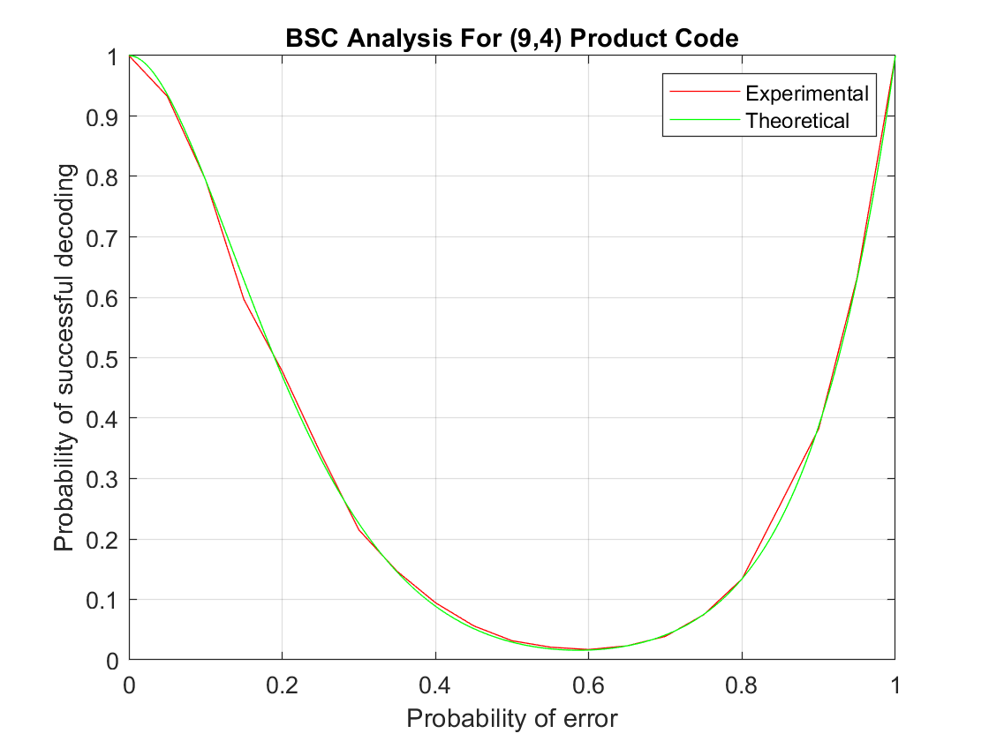
BSC ANALYSIS
This graph compares the experimental and theoretical results for (9,4) product code for BSC channel.
Theoretical graph comes by taking different values of probability for the equation of support matrix.
It matches to a great extent with the experimental graph.
We can observe that the graph suddenly rises towards the end. This is because our decoder is capable of recovering the original signal even if all the message bits are flipped.

Slide 34
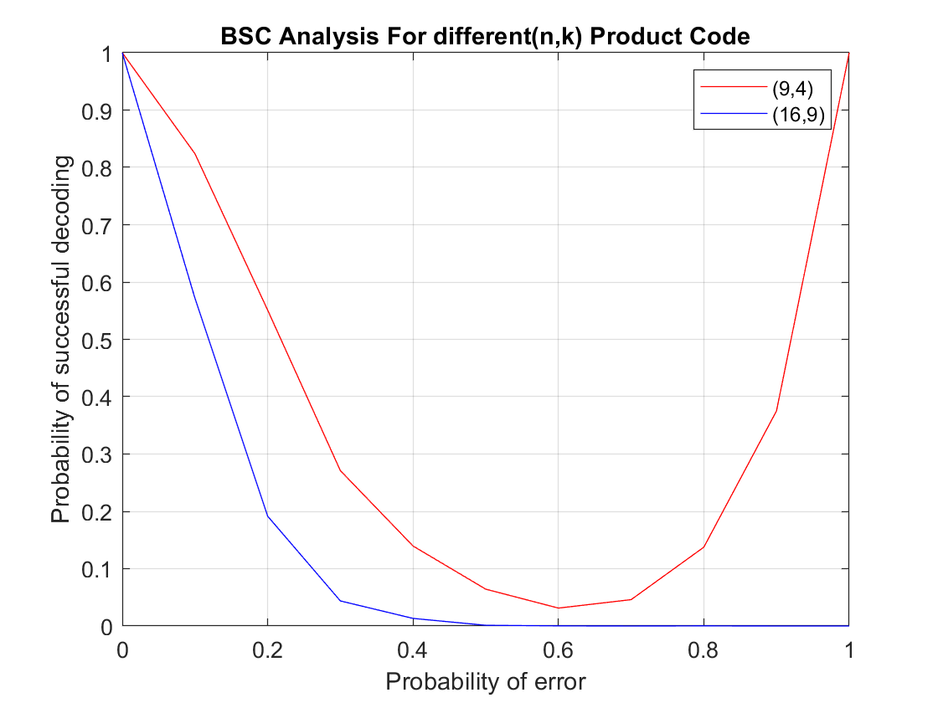
THE GRAPH AS SHOWN DEPICTS THE VARIATIONS IN THE DECODING BEHAVIOR OF THE DECODER OVER THE BSC CHANNEL AS THE NUMBER OF MESSAGE BITS INCREASE.
AS SHOWN, AS THE MESSAGE BITS INCREASE FROM 4 TO 9 THE MESSAGE WHICH COULD BE RECOVERED EARLIER EVEN IF ALL BITS WERE FLIPPED CAN NO LONGER BE OBTAINED NOW.
HENCE THE DECODER WHICH WAS ABLE TO GET THE ORIGINAL MESSAGE EARLIER EVEN IF ALL BITS WERE FLIPPED CAN’T OBTAIN THE MESSAGE NOW.
ONE MORE INFERENCE IS THAT THE MESSAGE WITH ALL BITS FLIPPED CAN BE OBTAINED BACK IF AND ONLY IF THE MESSAGE BITS ARE EVEN.
IF THERE WILL BE ODD NUMBER OF BITS, THE NUMBER OF COLUMNS WILL BE EVEN. WHEN ALL THE BITS ARE FLIPPED, TAKING THE XOR OF REMAINING ODD NUMBER OF BITS WILL ALWAYS REMAIN 1. THUS, (16,9) MESSAGE SIGNAL CAN NOT BE DECODED WHEN ALL BITS ARE FLIPPED.

Slide 35

EQUATION FOR BSC (N, K)
P(S) = ^{N}C₀ × P⁰ (1-P)^{N} + ^{N}C₁ × P (1-P)^{N-1} + K × P² (1-P)^{N-2} +
$\frac{1+\left(−1\right)K}{2}$ × P^{N} (1-P)⁰
PUTTING N = 9 AND K = 4 WE GET
P(S) = P⁰ (1-P)⁹ + 9 × P (1-P)⁸ + 4 × P² (1-P)⁷ + P⁹ (1-P)⁰
WHICH IS THEORETICAL ANALYSIS FOR (9,4) PRODUCT CODE FOR BSC CHANNEL
S = PROBABILITY OF SUCCESS

Slide 36
Observations
AS SEEN IN THE GRAPH, THE PROBABILITY OF SUCCESS DECREASES AS PROBABILITY OF ERROR INCREASES.
IF WE FLIP ALL THE BITS THEN ALSO WE CAN DECODE THE RECEIVED SIGNAL.

Slide 37
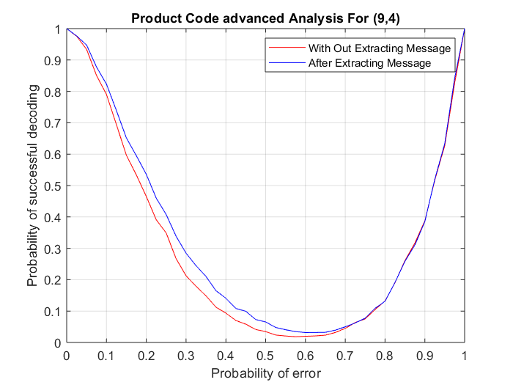
ADVANCED H ANALYSIS FOR (9, 4) PRODUCT CODE:
EXTRACTING MESSAGE IMPLY MORE PROBABILITY OF SUCCESS
The inference that can be taken from this graph is:
When we compare only the decoded information bits with original information bits, the probability of success seems somewhat high relative to that when we compare all the encoded bits with decoded bits.
The reason behind this could be that the information bits are correctly decoded but all the checker nodes may not have become zero.

Slide 38
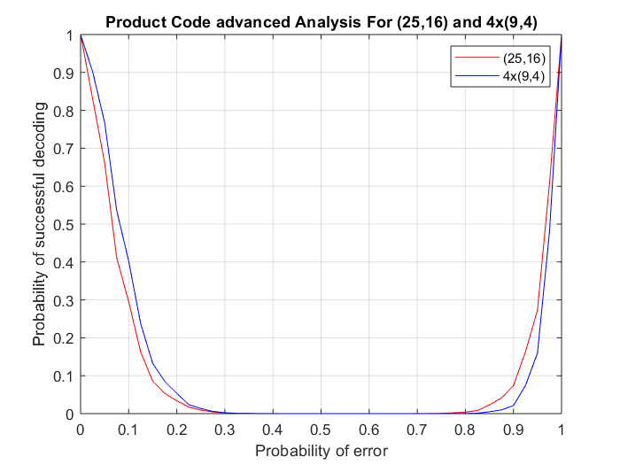
ADVANCED H ANALYSIS : (25, 16) Vs. 4×(9, 4)
SUPPOSE YOU WANT TO SEND 16 BIT MESSAGE SIGNAL.
SO THERE AER TWO
WAY TO SEND IT ONE IS TO SEND (25, 16) code or 4×(9, 4) code.
FIRST THING IS THAT RATE WILL DECREASE BY FACTOR OF 25/36.
BUT PROBABILITY OF SUCCESS INCREASES FOR LOWER PROBABILITY OF ERROR AND CAN BE SEEN CLEARLY IN GRAPH BELOW.

Slide 39
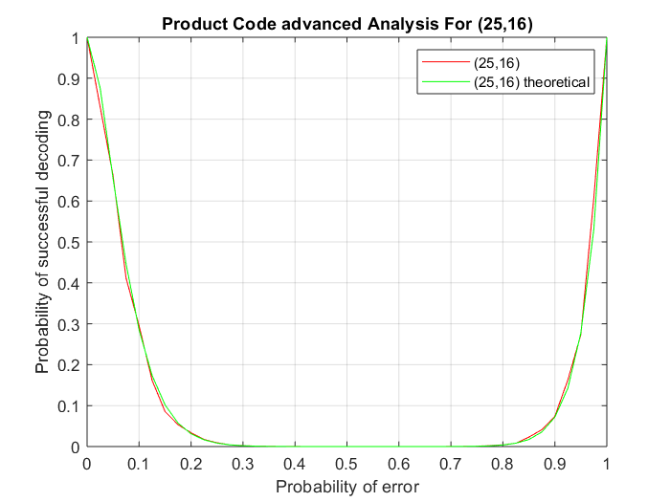
ADVANCED H ANALYSIS : (25, 16) Vs. 4×(9, 4) :
METHAMATICAL ANALYSIS
PUTTING N = 25 AND
K = 16 WE GET
P(S) = P⁰ (1-P)²⁵
+ 25 × P (1-P)²⁴ + 16 × P² (1-P)²³
+ P²⁵ (1-P)⁰
WHICH IS THEORETICAL ANALYSIS FOR (25,16) PRODUCT CODE FOR BSC CHANNEL

Slide 40
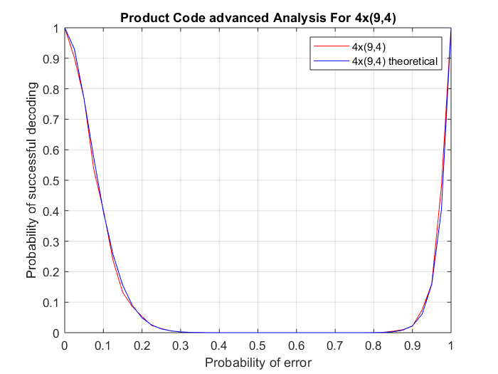
ADVANCED H ANALYSIS : (25, 16) Vs. 4×(9, 4) :
METHAMATICAL ANALYSIS
BUT FOR 4 × (9, 4)
P(S) = (P⁰ (1-P)9)⁴
+ (9 × P (1-P)⁸ )⁴ + (4 × P² (1-P)⁷ )⁴
+ (P⁹ × (1-P)⁰ )⁴
WHICH IS THEORETICAL ANALYSIS FOR 4×(9,4) PRODUCT CODE FOR BSC CHANNEL

Slide 41
LDPC codes
LOW DENSITY PARITY CODES ARE THE CODES WHERE THE DENSITY OF 1’S IS VERY LESS.
THE ENCODED LDPC MESSAGE BIT WAS ALREADY PROVIDED.
THE DECODING ALGORITHM FOR LDPC CODES REMAINS THE SAME AS THAT OF THE PRODUCT CODES (AS ALREADY DISCUSSED) .

Slide 42
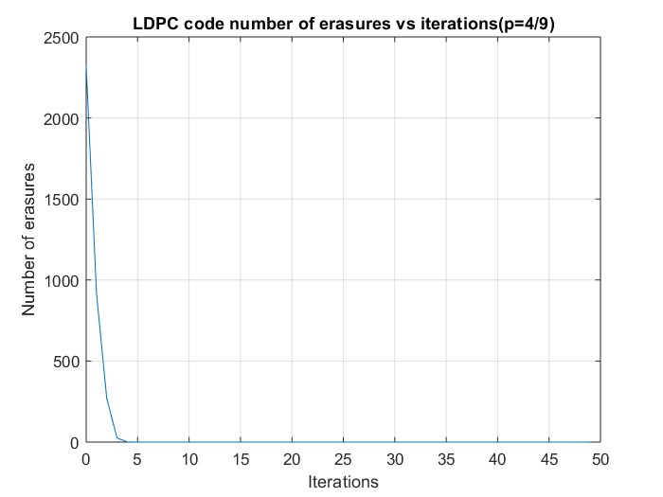
AS SHOWN IN THE FIGURE, FOR THE LDPC DECODING, AS THE NUMBER OF ITERATIONS IN THE MONTE CARLO SIMULATION INCREASES, THE NUMBER OF ERASURES DECREASE.

Slide 43
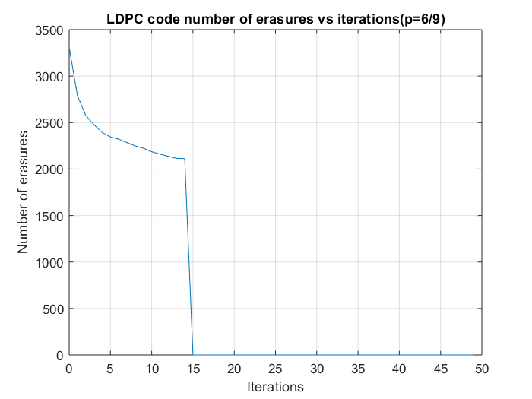
Probability of error considered here is high as a result of which the number of bits that are erased increase.
Hence the chances of a case arising where the successful decoding isn’t possible (i.e. a circuit of erasures being formed) increases.
In the code, when the value of all checker nodes does not change for two consecutive iterations, we terminate the code saying that it can not be decoded.
Here, the slant line going towards zero says the above thing.

Slide 44
conclusion

Slide 45
Thank you

